Slide 1
Oncogenic Mutations in Cbl Proteins
Frontiers in Mathematical Oncology:
Young Investigators Conference
April 26, 2017
Stan Lipkowitz MD, PhD
Women’s Malignancies Branch
Center for Cancer Research, NCI

Slide 2
Tyrosine Kinases and Cancer

Slide 3
The Cbl Family
TKB
v-Cbl
4H
EF
SH2
Y
Cbl
4H
Y
Y
Y
EF
SH2
L
RF
P
UBA
Y
Cbl-b
4H
L
RF
P
Y
Y
UBA
EF
SH2
Y
Cbl-c
4H
EF
SH2
L
RF
P
Y
Sea squirt Cbl
4H
L
RF
UBA
EF
SH2
P
Y
D-Cbl_{L}
4H
L
RF
UBA
EF
SH2
P
Y
D-Cbl_{S}
4H
EF
SH2
L
RF
Y
Sli-1
4H
EF
SH2
L
RF
P
Y
Sea urchin Cbl
EF
SH2
L
RF
P
Dicty Cbl
EF
SH2
RF
Nau and Lipkowtz in Cbl Proteins, ed. Alex Tsygankov, 2008

Slide 4
The Cbl Family
dictyostelium
Cbl-b
fruit fly
mosquito
zebrafish
sea squirt
rat
bee
frog
mouse
lizard
rhesus
chicken
human
sea urchin
chimp
cow
dog
zebrafish Cbl-x
C. briggsae
zebrafish
lizard Cbl-x
C. elegans (sli-1)
frog
mouse
cow
rat
rat
Cbl
lizard
mouse
rhesus
chicken
rhesus
cow
chimp
human
dog
dog
chimp
Cbl-c
human
Nau and Lipkowtz in Cbl Proteins, ed. Alex Tsygankov, 2008
0.1

Slide 5
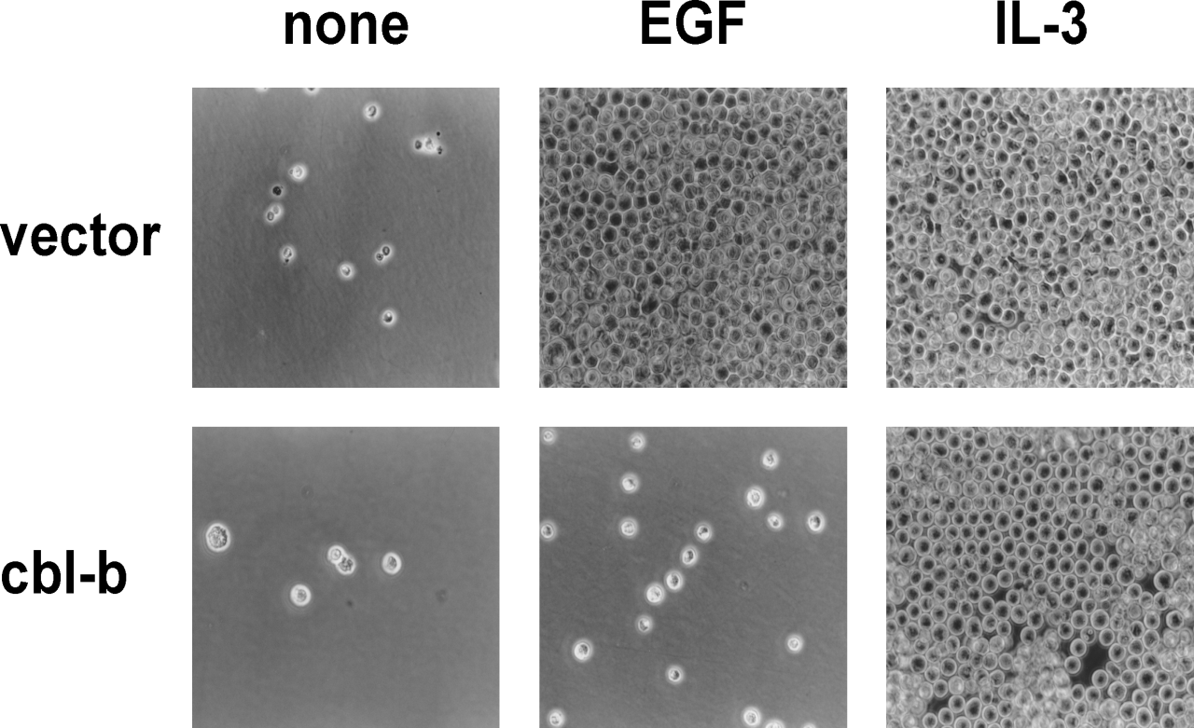
Cbl-b Inhibits EGF Dependent Growth of 32D/EGFR Cells
200
180
160
140
Cell Number (x10⁴)
120
100
80
60
40
20
0
EGF
IL-3
Ettenberg et al.
Oncogene 18: 1855-66, 1999
Growth Factor

Slide 6
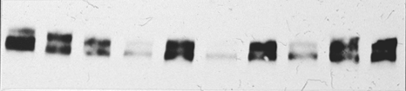
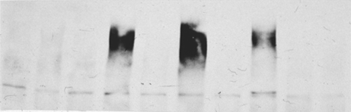
All Cbl proteins induce EGFR ubiquitination and degradation
]
]
]
]
]
Transfection: Cont. Cbl Cbl-b Cbl-3L Cbl-3S
EGF:
- +
- +
- +
- +
- +
IB Ab:
Anti-HA
(ubiquitin)
⇦
⬅
IB Ab:
Anti-EGFR
⇦
⬅
IP Ab: Anti-EGFR
Levkowitz et al. Mol Cell 4: 1029-40, 1999

Slide 7
E3 Determines Substrate Specificity for Ubiquitination
Lipkowitz and Weissman
Nature Reviews/Cancer 11, 629-43, 2011
Notes:
7
This is a model of how ubiquitination takes place in the cell. The cbl proteins have been previously characterized as E3 ubuquitin ligases. The ultimate purpose of ubiquitinating proteins is to tag them for proteosomal degredation.

Slide 8
Cbl Proteins Have a C3HC4 RING Finger
X (4-48)
C1
C6
H4
C7
X (2)
Zn²⁺
X (2)
X (2)
X (1-3)
Zn²⁺
X (2)
C2
C5
C3
C8
X (9-27)

Slide 9
Cbl RING Fingers
Nau and Lipkowtz in Cbl Proteins, ed. Alex Tsygankov, 2008

Slide 10
Cbl Linker Region
Nau and Lipkowtz in Cbl Proteins, ed. Alex Tsygankov, 2008

Slide 11
Cbl RING Finger Tail
Nau and Lipkowtz in Cbl Proteins, ed. Alex Tsygankov, 2008

Slide 12
Cbl Proteins Have a C3HC4 RING Finger
X (4-48)
X
C1
C6
H4
C7
X (2)
Zn²⁺
X (2)
X (2)
X (1-3)
Zn²⁺
X (2)
C2
C5
C3
C8
X (9-27)

Slide 13
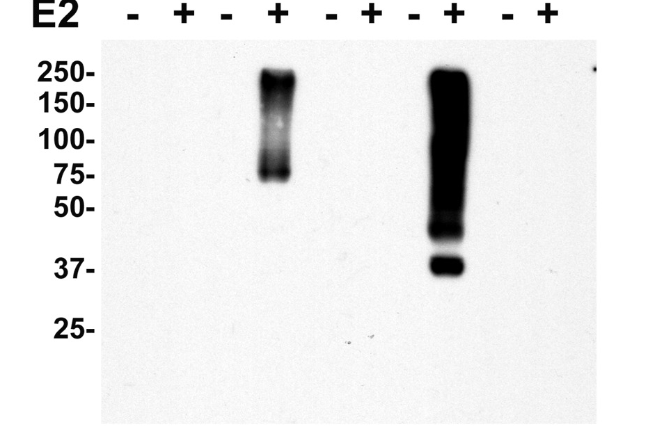
Cbl Proteins are Ubiquitin Ligases (E3s)
Cbl-b
Cbl-c
Gst
Wt
RFMt
Wt
RFMt
IB: anti Biotin

Slide 14
Cbl Proteins and RTK Regulation
Kales et al., Cancer Research 70; 4789, 2010

Slide 15
Cbl Proteins Summary 1
Cbl proteins are a family of RING Finger Ubiquitin Ligases (E3s)
They ubiquitinate many receptor tyrosine kinases
They regulate trafficking of RTKs through the endocytic pathway
They thus negatively regulate signaling
They ubiquitinate and regulate many non-receptor tyrosine kinases
e.g. Src kinases
They regulate many tyrosine kinases associated pathways
e.g. T-cell receptor, B-cell receptor

Slide 16
Oncogenic Mutations of Cbl Proteins
TKB
v-Cbl
4H
EF
SH2
Y
Cbl
4H
Y
Y
Y
EF
SH2
L
RF
P
UBA
Y
Cbl-b
4H
L
RF
P
Y
Y
UBA
EF
SH2
Y
Cbl-c
4H
EF
SH2
L
RF
P

Slide 17
Cbl Mutations and Cancer
70Z Cbl
CEPTPQDHIKVTQEQYELYCEMGSTFQLCKICAENDKDVKIEPCH
Andoniou et al., EMBO J 13; 4515, 1994

Slide 18
Cbl Mutations and Cancer
70Z Cbl
CEPTPQDHIKVTQEQYELYCEMGSTFQLCKICAENDKDVKIEPCH
Identified in a murine B-cell lymphoma (70Z/3 B-cell lymphoma)
Transforms in NIH3T3 cells and forms tumors in mice
Andoniou et al., EMBO J 13; 4515, 1994

Slide 19
Cbl Mutations and Cancer
70Z Cbl
Andoniou et al., EMBO J 13; 4515, 1994

Slide 20
Cbl and Human Myeloid Neoplasms
Mutations Homo Hetero
Pt 72(68%) 34(32%)
Del 6(28%) 13(72%)
Y371 22 (15%)
ΔExon 8 13 (9%)
C384 11 (7%)
R420 11 (7%)
L380 10 (7%)\
Kales et al., Cancer Research 70; 4789, 2010

Slide 21
Cbl and Human Myeloid Neoplasms
Acute Myelogenous Leukemia (AML)
sAML 10%
Myelodysplastic Syndrome (MDS)
Myelofibrosis
Atypical Chronic Myelogenous Leukemia (aCML) 8%
CML in Blast Crisis
Chronic Myelomonocytic Leukemia (CMML) 13%
Juvenile Myelomonocytic Leukemia (JMML) 15%
Kales et al., Cancer Research 70; 4789, 2010

Slide 22
Germline Cbl Mutations and Noonan-like Syndrome
Noonan Syndrome
Autosomal dominant congenital disorder
Congenital heart defects
Impaired growth and short stature
Learning disabilities
Pectus excavatum
Impaired blood clotting
Characteristic facial features (webbed neck, flat nose bridge)
Developmental Delay
Cryptorchidism
Disorder of Ras pathway (NRAS, HRAS, PTPN11)
Juvenile Myelomonocytic Leukemia (JMML)
JMML is also a RAS pathway disorder
~15% of patients with JMML have a Cbl mutation and uniparental disomy

Slide 23
Germline Cbl Mutations and Noonan Syndrome
*
*
Niemeyer et al., Nature Genetics 42;794-800, 2010
Martinelli et al., Am J Hum Gen 87;250-257, 2010
Perez et al., J Med Genetics 47, 686-691, 2010

Slide 24
Cbl Mutations and Solid Tumors

Slide 25
Cbl Family Mutations in Human Tumors

Slide 26
Analysis of Cbl Mutations from Human Cancers
Anna Panchenko
Minghui Li
Ben Shoemaker

Slide 27
Model for Cbl Activation
Dou et al., NSMB 19, 184-93, 2012
Kales et al., NSMB 19; 131-2, 2012

Slide 28
Cbl Structures
Zheng et al., Cell 102: 533-39, 1999
Dou et al., NSMB 19: 184-93, 2012

Slide 29
Analysis of Cbl Mutations from Human Cancers
Anna Panchenko NCBI
Minghui Li
Ben Shoemaker
Protein Folding (FoldX)
Cbl/E2 Binding
Li et al., Cancer Research 76: 571, 2017

Slide 30
Analysis of Cbl Mutations from Human Cancers
Anna Panchenko NCBI
Minghui Li
Ben Shoemaker
Li et al., Cancer Research 76: 571, 2017

Slide 31
Do All Cancer Cbl Mutations Abrogate E3 Activity?
Li et al., Cancer Research 76: 571, 2017

Slide 32
Not all Mutations in Cbl Decrease the E3 Activity
Li et al., Cancer Research 76: 571, 2017

Slide 33
Correlation of Predicted and Observed Results
Li et al., Cancer Research 76: 571, 2017

Slide 34
Correlation Between Predicted and Observed Results
for Mutations found in Cancer Samples
Li et al., Cancer Research 76: 571, 2017

Slide 35
Cbl Proteins Summary 2
Mutations of Cbl Account for ~5% of Human Myeloid Neoplasms
Mutations are most commonly homozygous point mutations
Mutations result in loss of E3 activity
Mutations of Cbl proteins can be found in murine and human solid tumors
Missence mutations are most common
Some of the mutations abrogate E3 activity
The challenges for the future:
Determining which mutations are significant
Identifying the pathways affected (e.g., therapuetic targets)

Slide 36
Lab Members
Current Lab Members:
Lab Alumni:
Sam Gilbert
Yoshimi Greer
Mariya Liyosova
Ke Ma
Donna Voeller
Jing Bao
Ashley Coats
Juan Cresp-Barreto
Maurico Cuello
Jill Chavez
Isaac Darko
Gareth Davies
Jennifer Dine
Seth Ettenberg
Sireesha Garimella
Stephen Kales
Jeremy Karlin
Maccon Keane
Amanda Lowrey
Geoff Lowrey
Lyndsay Murrow
Marion Nau
Janet Pumphrey
Monzur Rahman
Andrea Rocca
Yaffa Rubinstein
Phil Ryan
Nina Sivadasan
Brandon Stone
Rajgopal Yadavalli
Collaborators
Allan Weissman NCI
Jeff Green NCI
Anna Panchenko NCBI
Minghui Li
Ben Shoemaker
Ivan Dikic Goethe University, Frankfurt, Germany
Morag Park McGill University, Quebec, Canada
Josef Penninger Institute for Molecular Technology, Vienna, Austria
Yossi Yarden Weizmann Institute of Science, Rehovot, Israel

